Slide 1
TOWARDS A SDN-BASED INTEGRATED ARCHITECTURE FOR MITIGATING IP SPOOFING ATTACK
Abhinav TK
Class no: 3 s7 btech cse

Slide 2
CONTENTS
TOWARDS A SDN-BASED INTEGRATED ARCHITECTURE FOR MITIGATING IP SPOOFING ATTACK
INTRODUCTION
RELATED WORKS
FORMALISED DESCRIPTION
THREAT MODEL
SYSTEM ARCHITECTURE
INTRA-DOMAIN SOLUTION
INTER-DOMAIN SOLUTION
ISSUES
CONCLUSION

Slide 3
INTRODUCTION
TOWARDS A SDN-BASED INTEGRATED ARCHITECTURE FOR MITIGATING IP SPOOFING ATTACK
IP source address spoofing
Packet forwarding relies on destination IP address
Neglects validation of IP source address
Attacks
TCP-SYN flooding
DDoS
DRDoS
DNS request reflection
NTP synchronization reflection

Slide 4
INTRODUCTION (contd…)
TOWARDS A SDN-BASED INTEGRATED ARCHITECTURE FOR MITIGATING IP SPOOFING ATTACK
Making use of Software Defined Networking (SDN)
Cover both intra- and inter-domain
Low SDN devices deployment cost.
Intra-domain
Key nodes replaced by SDN switches
Balance between fake packets filtering rate and deployment cost
Inter-domain
Time-synchronized packet signing and verification

Slide 5
RELATED WORK: INTRA-DOMAIN
TOWARDS A SDN-BASED INTEGRATED ARCHITECTURE FOR MITIGATING IP SPOOFING ATTACK
IP source address filtering
unicast Reverse Path Forwarding (uRPF)
IP source address encryption
Cryptographically Generated Addresses (CGA)
Protocol and host-stack redesign
Host Identity Protocol (HIP)

Slide 6
RELATED WORK: INTER-DOMAIN
TOWARDS A SDN-BASED INTEGRATED ARCHITECTURE FOR MITIGATING IP SPOOFING ATTACK
End-based source address filtering
CatchIt
Path-based source address filtering
IDPF
End-to-end (e2e)-based source address filtering
Spoofing Prevention Method (SPM)
Notes:
Inter Domain Packet Filters

Slide 7
FORMALIZED DESCRIPTION
TOWARDS A SDN-BASED INTEGRATED ARCHITECTURE FOR MITIGATING IP SPOOFING ATTACK
Network Topology , TopoD = G(V,E)
Hosts , HOSTD = { H1,H2,…HS}
Users , USERD = {U1,U2,…UQ}
IPs , IPD = {IP1,IP2,…IPM}
IP packet = {version,length,IPsrc,IPdst,data..}

Slide 8

FORMALIZED DESCRIPTION (contd…)
TOWARDS A SDN-BASED INTEGRATED ARCHITECTURE FOR MITIGATING IP SPOOFING ATTACK
Packet Reliability
IP source address credibility
User credibility

Slide 9
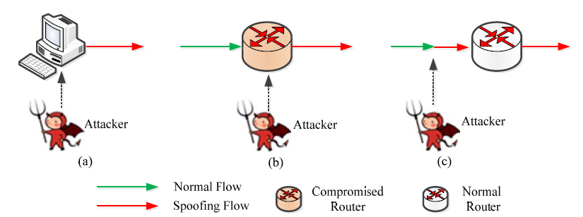
THREAT MODEL
TOWARDS A SDN-BASED INTEGRATED ARCHITECTURE FOR MITIGATING IP SPOOFING ATTACK
Host-based attack Router-based attack Flow-based attack
Courtesy:https://ieeexplore.ieee.org/document/8226750

Slide 10
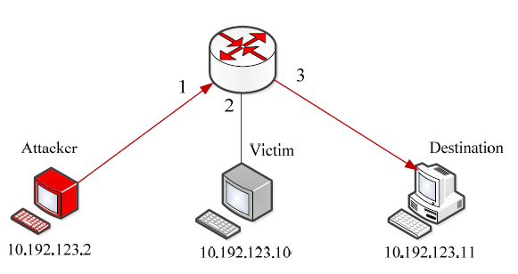
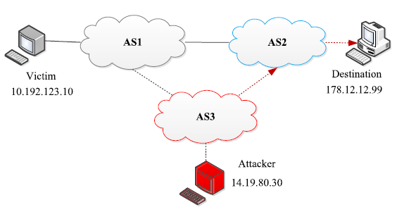
ATTACK SCENARIOS
TOWARDS A SDN-BASED INTEGRATED ARCHITECTURE FOR MITIGATING IP SPOOFING ATTACK
Intra-domain spoofing
Inter-domain spoofing
Courtesy:https://ieeexplore.ieee.org/document/8226750

Slide 11
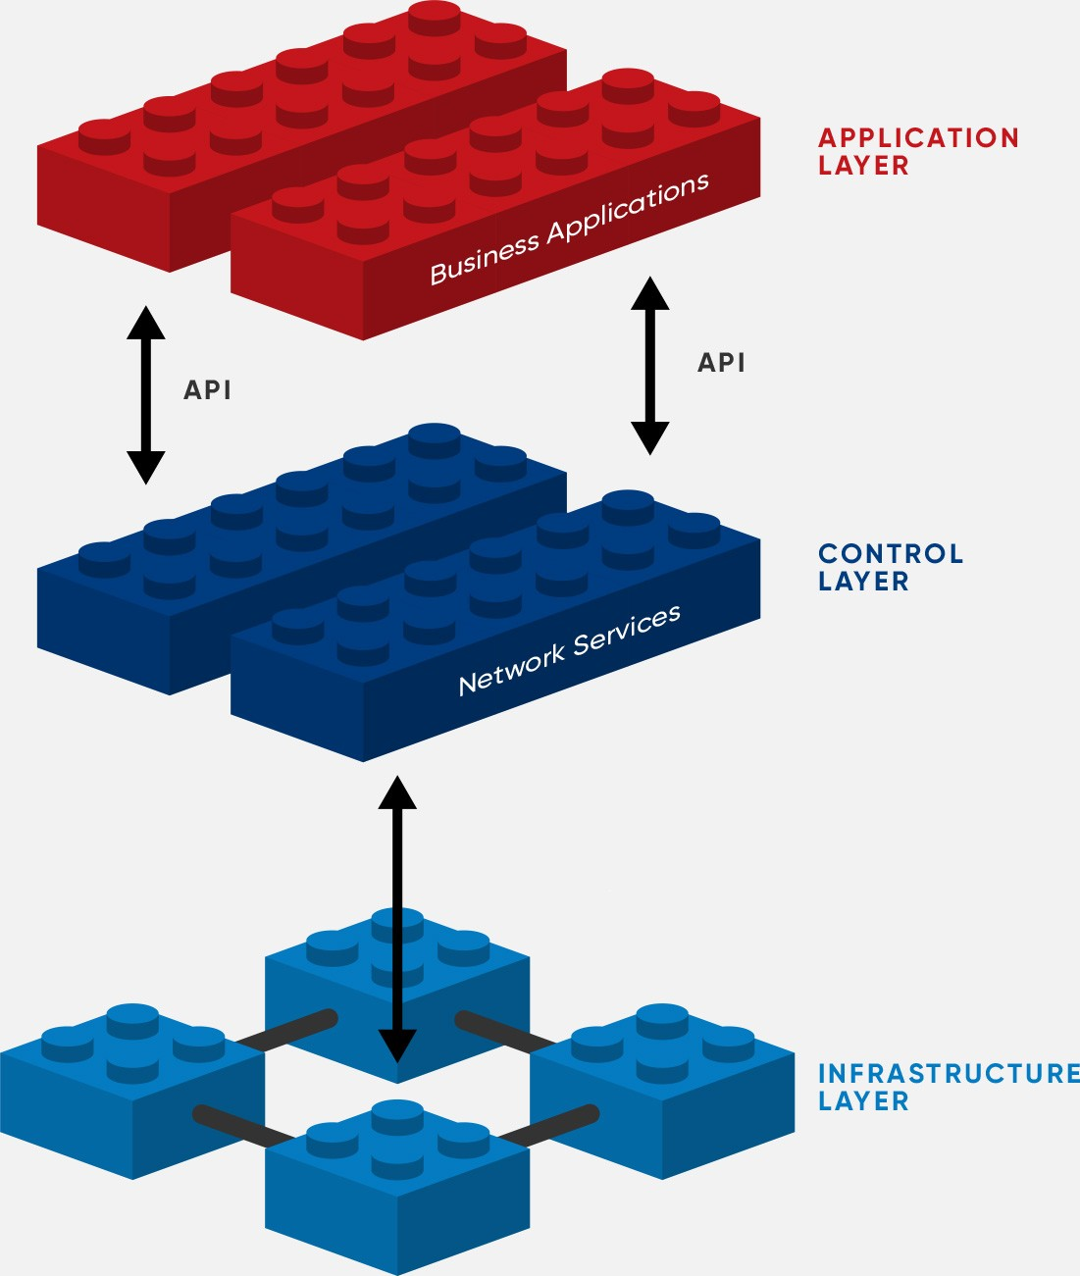
SOFTWARE-DEFINED NETWORKING
TOWARDS A SDN-BASED INTEGRATED ARCHITECTURE FOR MITIGATING IP SPOOFING ATTACK
Decouples network control and forwarding functions
Network control directly programmable
SDN Routers in Infrastructure layer
N/W Controllers in Control layer
Application Layer directs Security and Management
Virtual Load Balancer
Virtual Firewall
Courtesy:https://opennetworking.org/sdn-definition

Slide 12
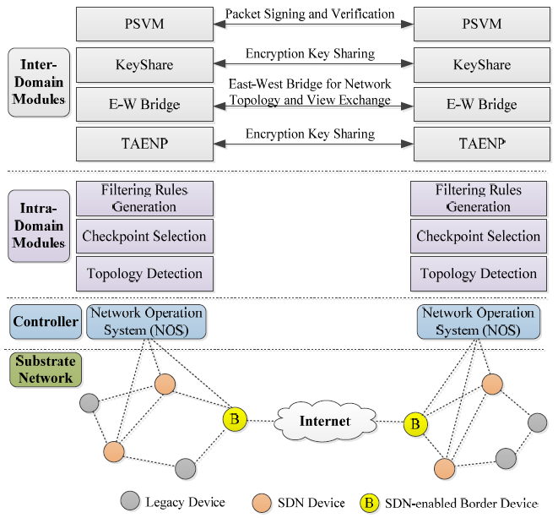
SYSTEM ARCHITECTURE
TOWARDS A SDN-BASED INTEGRATED ARCHITECTURE FOR MITIGATING IP SPOOFING ATTACK
Courtesy:https://ieeexplore.ieee.org/document/8226750

Slide 13
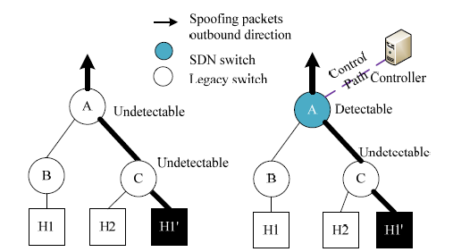
INTRA-DOMAIN SOLUTION
TOWARDS A SDN-BASED INTEGRATED ARCHITECTURE FOR MITIGATING IP SPOOFING ATTACK
SAVSH - Source Address Validation for SDN Hybrid network
Before SDN Deployment After SDN Deployment
Courtesy:https://ieeexplore.ieee.org/document/8226750

Slide 14
INTRA-DOMAIN SOLUTION STEPS
TOWARDS A SDN-BASED INTEGRATED ARCHITECTURE FOR MITIGATING IP SPOOFING ATTACK
Locate deployment nodes and prioritize them
Design controller application to distribute appropriate rules
{Import, SIP, DIP, Action}
Adapt to network dynamics.

Slide 15

CONVERTING TOPOLOGY INTO SINK-TREE
TOWARDS A SDN-BASED INTEGRATED ARCHITECTURE FOR MITIGATING IP SPOOFING ATTACK
Assumptions
Multiple links between two nodes are treated as one
Link bandwidth or quality not considered
Focuses on single-homing scenarios
Initial topology as a DAG with the border router as root node
A as parameter of the Dijkstra algorithm to shape the tree

Slide 16
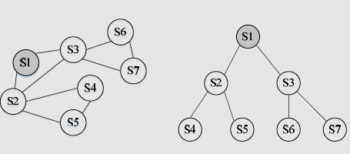
CONVERTING TOPOLOGY INTO SINK-TREE
TOWARDS A SDN-BASED INTEGRATED ARCHITECTURE FOR MITIGATING IP SPOOFING ATTACK
Courtesy:https://ieeexplore.ieee.org/document/8226750

Slide 17

LOCATING SDN DEPLOYMENT NODES
TOWARDS A SDN-BASED INTEGRATED ARCHITECTURE FOR MITIGATING IP SPOOFING ATTACK
pci – Set of IP prefixes covered by node i
ui- Utility that can be checked by node i

Slide 18
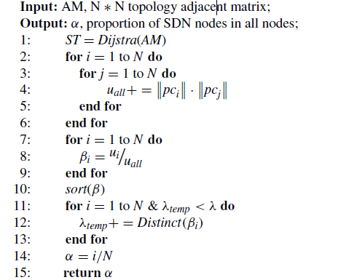
SDN DEPLOYMENT NODES SELECTION ALGORITHM
TOWARDS A SDN-BASED INTEGRATED ARCHITECTURE FOR MITIGATING IP SPOOFING ATTACK
Courtesy:https://ieeexplore.ieee.org/document/8226750

Slide 19
DISTRIBUTING FILTERING RULE GENERATION
TOWARDS A SDN-BASED INTEGRATED ARCHITECTURE FOR MITIGATING IP SPOOFING ATTACK
Legal prefixes sorted in all ports
Organizes all possible prefix pairs
Forms corresponding forwarding rules
Forbidden rules to block illegal prefix pair

Slide 20
COPING WITH NETWORK DYNAMICS
TOWARDS A SDN-BASED INTEGRATED ARCHITECTURE FOR MITIGATING IP SPOOFING ATTACK
Large latency for sink-tree reshaping and rule recalculation
Proactive and Reactive ways

Slide 21
INTER-DOMAIN SOLUTION
TOWARDS A SDN-BASED INTEGRATED ARCHITECTURE FOR MITIGATING IP SPOOFING ATTACK
Trust Alliance Establishment & Negotiation Protocol
Network View And Secret Key Sharing
Packet Signing And Verification

Slide 22

TRUST ALLIANCE ESTABLISHMENT & NEGOTIATION PROTOCOL
TOWARDS A SDN-BASED INTEGRATED ARCHITECTURE FOR MITIGATING IP SPOOFING ATTACK
Connect peer AS controller and identify peer's identity
Exchange information
AS number
range list of domain IP address
Leader elected for initial connecting in the further interactions.

Slide 23
NETWORK VIEW AND SECRET KEY SHARING
TOWARDS A SDN-BASED INTEGRATED ARCHITECTURE FOR MITIGATING IP SPOOFING ATTACK
Different domains have different policies
Admins only expose partial or abstract network topology
EW-Bridge abstract physical topology as a virtual network view
Virtual links and nodes to achieve the purpose in a private and secure manner.

Slide 24
NETWORK VIEW AND SECRET KEY SHARING
TOWARDS A SDN-BASED INTEGRATED ARCHITECTURE FOR MITIGATING IP SPOOFING ATTACK
Symmetric encryption key securely shared between each pair of peers
Diffie-Hellman algorithm
NTP synchronize two peers' time
Secret key updated in a fixed time interval
Replay attack prevented

Slide 25
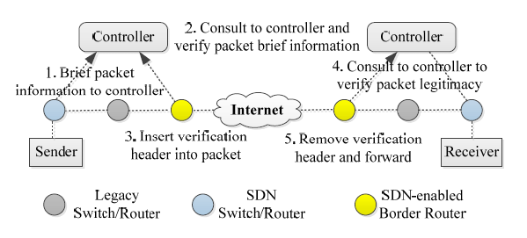

PACKET SIGNING AND VERIFICATION
TOWARDS A SDN-BASED INTEGRATED ARCHITECTURE FOR MITIGATING IP SPOOFING ATTACK
Courtesy:https://ieeexplore.ieee.org/document/8226750

Slide 26
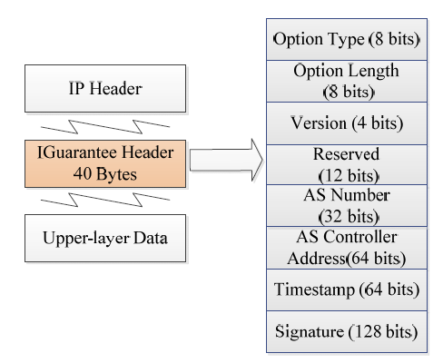
IGUARANTEE HEADER
TOWARDS A SDN-BASED INTEGRATED ARCHITECTURE FOR MITIGATING IP SPOOFING ATTACK
Courtesy:https://ieeexplore.ieee.org/document/8226750
Notes:
Hash based message authentication code

Slide 27
CONCLUSION
TOWARDS A SDN-BASED INTEGRATED ARCHITECTURE FOR MITIGATING IP SPOOFING ATTACK
Integrated IP spoofing validating solution
For both intra-domain and inter-domain scenarios
The intra-domain part scheme computes key network nodes
Replaced by SDN switches on these nodes
Filtering rules distributed by controller based on network real-time topology
Time-synchronized packet signing and verification
90% filtering rates at 10% deployment

Slide 28
REFERENCES
TOWARDS A SDN-BASED INTEGRATED ARCHITECTURE FOR MITIGATING IP SPOOFING ATTACK
[1] W. M. Eddy, ``Defenses against TCP SYN ooding attacks,'' Internet
Protocol J., vol. 9, no. 4, pp. 216, 2006.
[2] D. Senie and P. Ferguson, Network Ingress Filtering: Defeating
Denial of Service Attacks Which Employ IP Source Address Spoong,
document RFC 2267, 1998.
[3] The Indian Computer Emergency Response Team. CERT Advisory Smurf
IP Denial-of-Service Attacks. Accessed: Dec. 6, 2017. [Online]. Available:
http://www/cert.org/advisories/CA-1998-01.html
[4] Wikipedia. DR-DOS. Accessed: Dec. 6, 2017. [Online]. Available:
https://en.wikipedia.org/wiki/DR-DOS

Slide 29
THANK YOU
TOWARDS A SDN-BASED INTEGRATED ARCHITECTURE FOR MITIGATING IP SPOOFING ATTACK

